Slide 1
Ethical Hacking
Mohona Ghosh

Slide 2
Session Hijacking

Slide 3
TCP Session
TCP 3-way handshake
For two machines to communicate via TCP they must have to synchronize their session through Synchronize and Acknowledgement Packets. Every single packet is given a sequence number which helps the receiving host to synchronize and reassemble the stream of packets back into their original and intended order.

Slide 4
TCP Session
TCP session establishment is as follows:
Client sends a SYN request to server with initial sequence number X.
Server sends the SYN/ACK packet publishing its own Sequence number SEQ y and Acknowledgement number ACK for the client’s original SYN packet. The ACK indicates the next SEQ number expected from client by the server.
Client acknowledges the receipt of the SYN/ACK packet from the server by sending the ACK number which will be the next sequence number expected from the server, y+1 in this case

Slide 5
TCP Session
After being established through the handshaking process, the TCP sequence numbers will be used in sequential order until the session is terminated. The sequence numbers allow all the data to arrive in order (or in the correct sequence).
Each system must choose an initial sequence number at random that will be used to identify bytes in the stream it is sending.
The arbitrary initial sequence number is required to increment approximately every 4 µs, this avoids delayed segments from a previous connection getting mixed up with a new connection. The initial sequence number will wrap in about 4½ hours. Once a connection is established the sequence numbers can wrap much more quickly depending on traffic and line speed.
Once the connection has been established, data can flow in both directions equally well. There is no master or slave.

Slide 6
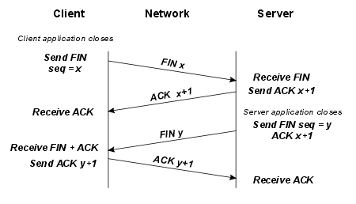
TCP Session
While it takes three segments to establish a connection, it takes four to terminate a connection
This is caused by TCP's half-close. Since a TCP connection is full-duplex (that is, data can be flowing in each direction independently of the other direction), each direction must be shut down independently.
The rule is that either end can send a FIN when it is done sending data. When a TCP receives a FIN, it must notify the application that the other end has terminated that direction of data flow. The sending of a FIN is normally the result of the application issuing a close.
The orderly close down of a TCP connection is illustrated in the diagram below.

Slide 7
TCP Session
Several heavily used Internet applications such as FTP, GOPHER, and HTTP use a protocol model in which every transaction requires a separate TCP connection. Since clients normally issue multiple requests to the same server, this model is quite inefficient, as it incurs all the connection start up costs for every single request.
Session Control Protocol (SCP) is a simple protocol which lets a server and client have multiple sessions over a single TCP connection. The protocol is designed to be simple to implement, and is modelled after TCP.

Slide 8
Connection vs session
A connection is a communication channel between a client and a server
Connections are usually short lived and servers are usually configured to timeout a connection if it is left idle for too long
Session is just a set of negotiated cryptography parameters
Created by the Handshake Protocol
Session is a way of maintaining state on the server side.

Slide 9
Connection vs session
One can think of it as a memory chunk allocated on the server and this memory chunk is associated with a connection
Even if a connection dies, one can resume a session (using cookies in case of HTTP protocol)
One can even close connection, but keep session, even store it to disk, and subsequently resume it using another connection, may be in completely different process, or even after system reboot
One can also renegotiate TLS parameters and create entirely new session without interrupting connection.

Slide 10
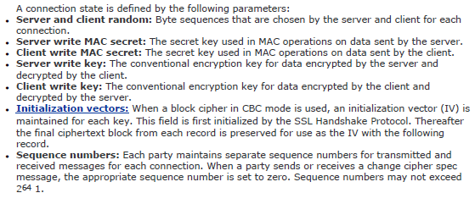
TCP Connection

Slide 11
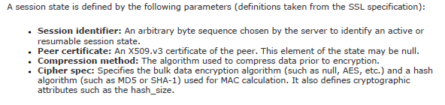
TCP Session

Slide 12
TCP Session
One a session has been opened, the application can send messages over it, and signal the end of connection level messages.
These messages are encapsulated in SCP packets and transferred over the byte stream. Messages can be split up into several different packets.
The header contains three fields; a flag byte, the session identifier, and the packet length.
FLAGS
+--------+--------+--------+--------+
+SFRP0000 | Session ID |
+--------+--------+--------+--------+
| LENGTH |
+--------+--------+--------+--------+

Slide 13
TCP Session
The session ID is usually a long, randomly-generated alpha-numeric string
This session ID is created and assigned to a user when they are first authenticated.
This session ID is stored on the server and usually kept "alive" for as long as the user is using the web-application, and erased when the user log's out or the session times out after a predefined inactivity period.
The session ID is associated with a specific user via a variety of means, most commonly by setting a cookie.
Many applications simply append the session ID to all page URLs, making session hijacking attacks much easier
A URL containing the session ID might look something like:
http://www.123somesite.com/view/7AD30725122120803
FLAGS
+--------+--------+--------+--------+
+SFRP0000 | Session ID |
+--------+--------+--------+--------+
| LENGTH |
+--------+--------+--------+--------+

Slide 14
Session Hijacking
Session hijacking involves an attacker using captured, brute forced or reverse-engineered session IDs to seize control of a legitimate user's session while that session is still in progress.
Through session hijacking, after the user is authenticated on the server, the attacker can take over (hijack) the session by using the same session ID for their own browser session. The server is then fooled into treating the attacker’s connection as the original user’s valid session.
In most applications, after successfully hijacking a session, the attacker gains complete access to all of the user's data, and is permitted to perform operations instead of the user whose session was hijacked.

Slide 15
Session Hijacking
2 types of session hijacking:
Application level session hijack – E.g., hijack http protocol session by stealing the valid session ID
Network level session Hijack – E.g., TCS session hijack by predicting correct packet sequence numbers
Attacker may try to hijack session at both levels together or at individual level depending upon the type of attack launched.

Slide 19
An example of stealing Session ID
HTTP Referer attack
The HTTP referer is an HTTP header field that identifies the address of the webpage (i.e. the URI uniform resource identifier) that is linked to the resource being requested.
In the most common situation, when a user clicks a hyperlink in a web browser, the browser sends a request to the server holding the destination webpage. The request includes the referrer field, which indicates the last page the user was on (the one from where they clicked the link)
Referer logging is used to allow websites and web servers to identify where people are visiting them from, for promotional or statistical purposes

Slide 20
An example of stealing Session ID

Slide 21
Session Hijacking Process
Consists of 4 phases:
Tracking the connection
Session ID retrieval/Predicting the correct sequence numbers
Desynchronizing the connection
Injecting the attacker’s packet

Slide 22
Session Hijacking Process
The first step in the session hijack attack is locating a target user. Attackers look for two things prior to their attack- first, they look for networks that have a high level of utilization; high volume networks help attackers to remain anonymous and they also provide a healthy supply of users to choose from, which also helps the attack. Secondly, users who use insecure network protocols such as Telnet, rlogin (remote login), and FTP (file transfer protocol) are easy targets due to their inherently insecure design (don’t use encryption). Packet sniffing software can be used to sniff network traffic for the purpose of locating vulnerable protocols like FTP, Telnet, and rlogin. Port scanning software can also be used to identify servers that have FTP, Telnet, or rlogin ports open.

Slide 23
Session Hijacking Process
Session ID retrieval/Predicting the correct sequence numbers
The attacker tries to predict the session id using available information through:
Brute Force
Stealing
Calculating
Now that a target has been chosen, the next step in the session hijacking process is sequence number prediction. Sequence number prediction is a critical step because failing to predict the correct sequence number will result in the server sending reset packets and terminating the connection attempt. If the attacker guesses the sequence numbers wrong repeatedly, the likelihood of detecting the attack increases.

Slide 24
Session Hijacking Process
Desynchronization of the network
The goal of the TCP session hijacker is to create a state where the client and server are unable to exchange data, so that he can forge acceptable packets for both ends, which mimic the real packets. Thus, he is able to gain control of the session.
i.e., the attacker will impersonate a trusted host and communicate with the server. At the same time, the attacker will disable the trusted host and make certain that no network traffic gets to the trusted host.
A desynchronized state is when a connection between the target and host is not in the established state (state where the TCP session is open and data is being exchanged); or in a stable state with no data transmission; or the server's sequence number is not equal to the client’s acknowledgement number; or the client's sequence number is not equal to the server’s acknowledgement number.

Slide 25
Session Hijacking Process
Desynchronization of the network
To desynchronize the connection between the target and host, the sequence number or the acknowledgement number (SEQ/ACK) of the server must be changed. This is done by sending null data to the server so that the server's SEQ/ACK numbers can advance while the target machine cannot register such an increment.
For example, before desynchronization, the attacker monitors the session without any kind of interference. The attacker then sends a large amount of "null data" to the server. This data serves only to change the ACK number on the server and does not affect anything else. Now, both the server and target are desynchronized.

Slide 26
Session Hijacking Process
The desynchronizing stage is added in the hijack sequence so that the target host is ignorant about the attack. Without desynchronizing, the attacker is able to inject data to the server and even keep his/her identity by spoofing an IP address. However, he/she has to put up with the server's response being relayed to the target host as well.
In desynchronized state, the client and server will drop packets sent between them because the server’s sequence number no longer matches the client’s ACK number and likewise, the client’s sequence number no longer matches the server’s ACK number.

Slide 27
Session Hijacking Process
Desynchronization of the network
To achieve the creation of the desynchronized state, the hijacker will do the following:
IP Spoofing: (Source Routed Packets) IP spoofing is “a technique used to gain unauthorized access to computers, whereby the intruder sends messages to a computer with an IP address indicating that the message is coming from a trusted host.” The trusted host, in the case of session hijacking, is the client. In employing this technique, the session hijacker obtains the IP address of the client and modifies packet headers to indicate that they come from that IP address. This technique allows the hijacker to create his/her own acceptable packets to inject into the TCP Session. The packets are source-routed, meaning that the sender specifies the route the packet will take to get to the destination IP. Using these source-routed packets, the hijacker can route the packets to his host and fool the server into thinking it is communicating with the victim (the client). Once the hijacker has successfully spoofed an IP address, he determines the next sequence number that the server expects and uses it to inject the forged packet into the TCP session before the client can respond. By doing so, he creates the “desynchronized state.” The sequence and ACK numbers are no longer synchronized between client and server, because the server registers having received a new packet that the client never sent.

Slide 28
Desynchronization of the network
One way to enable IP spoofing is through ARP spoofing
ARP stands for Address Resolution Protocol
ARP tables are used by each host to map local IP addresses to hardware addresses or MAC addresses
ARP spoofing involves sending out forged ARP replies to fool the host broadcasting the ARP request into updating his ARP table, mapping the IP to be impersonated to the hijacker’s hardware address
The attacker uses ARP spoofing to have the legitimate user's machine and the remote host both send their packets to his attacking machine, instead of their correct destinations. The attacker is now a man-in-the-middle. He controls all the packet flow between machines. He can then choose to alter and forward the packets to the real host

Slide 29
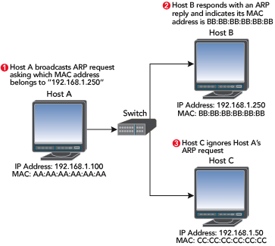
ARP Spoofing
ARP Table modifications
The address resolution protocol is used by each host on an IP network to map local IP addresses to hardware addresses or MAC addresses.
Here is a quick look at how this protocol works.

Slide 30
Say that Host A (IP address 192.168.1. 100) wants to send data to Host B (IP address 192.168.1.250).
No prior communications have occurred between Hosts A and B, so the ARP table entries for Host B on Host A are empty
As shown in Figure, Host A broadcasts an ARP request packet indicating that the owner of the IP address 192.168.1.250 should respond to Host A at 192.168.1.100 with its MAC address.
The broadcast packet is sent to every machine in the network segment, and only the true owner of the IP address 192.168.1.250 should respond

Slide 31
All other hosts discard this request packet, but Host A receives an ARP reply packet from Host B indicating that its MAC address is BB:BB:BB:BB:BB:BB.
Host A updates its ARP table, and can now send data to Host B.
In order to populate its ARP cache a machine trusts the senders of the ARP messages not to lie.
Does Host A know that Host B really did send the ARP reply? The answer is no, and attackers take advantage of this

Slide 32
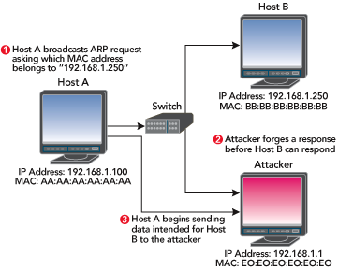
In our example, attackers could spoof an ARP reply to Host A before Host B responded, indicating that the hardware address E0:E0:E0:E0:E0:E0 corresponds to Host B's IP address, as shown in Figure
Host A would then send any traffic intended for Host B to the attacker, and the attacker could choose to forward that data (probably after some tampering) to Host B.

Slide 33
Desynchronization of the network

Slide 34
Desynchronization of the network
Drawback : TCP ACK Packet Storms
Happens when attacker can inject data but not control the route of the packet
E.g., if the attacker is not on the same network as the source host machine
Assume that the attacker has forged the correct packet information (headers, sequence numbers, and so on) at some point during the session.
When the attacker sends to the server session data, the server will acknowledge the receipt of the data by sending to the real client an ACK packet.
This packet will contain a sequence number that the client is not expecting, so when the client receives this packet, it will try to resynchronize the TCP session with the server by sending it an ACK packet with the sequence number that it is expecting.
This ACK packet will in turn contain a sequence number that the server is not expecting, and so the server will resend its last ACK packet. This cycle goes on and on and on, and this rapid passing back and forth of ACK packets creates an ACK storm

Slide 35
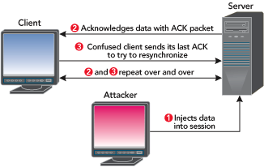
Desynchronization of the network
TCP ACK Packet Storms
As the attacker injects more and more data, the size of the ACK storm increases and can quickly degrade network performance
This can then be detected by intrusion detection methods
Attackers many times use ARP packet manipulation to quieten TCP ACK storms

Slide 36
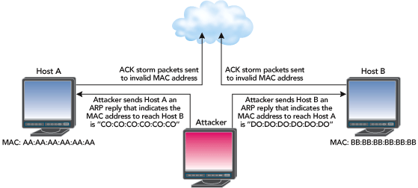
Prevent TCP ACK Storm
Attackers use ARP packet manipulation to quieten TCP ACK storms
Session hijacking tools accomplish this by sending unsolicited ARP replies.
In our Host A/Host B example, an attacker could send Host A a spoofed ARP reply indicating that Host B's MAC address is something nonexistent (like C0:C0:C0: C0:C0:C0), and send Host B another spoofed ARP reply indicating that Host A's MAC address is also something nonexistent (such as D0:D0:D0:D0:D0:D0)
Any ACK packets between Host A and Host B that could cause a TCP ACK storm during a network-level session hijacking attack are sent to invalid MAC addresses and lost.

Slide 37
Session Hijacking Process
Injecting the attacker’s packet
To completely take over the connection, the attacker stops forwarding packets for the legitimate user's machine associated with the hijacked TCP connection
The attacker now fully takes the place of the legitimate user's machine and the remote target host is not aware of the switch
The attacker can choose either to inject data into the network or actively participate as the man-in-the-middle, passing data from the target to the server, and vice versa, reading and injecting data as per wish
To the legitimate user's machine the connection has "gone-dead” as her connections will eventually time-out

Slide 38
Session Hijacking Process
TCP Resynchronizing
To hide his tracks, an attacker who is finished with the session hijacking attack might want to resynchronize the communicating hosts
The problem is that after the attack, the two hosts whose session was hijacked will be at different points in the session. In other words, each host will be expecting different sequence numbers.
For example, the server might think that it is 40 bytes into the session when really the client might have sent only 29 bytes. Thus, the expected sequence numbers on each side will differ. Since sequence numbers move in only a positive direction, it's not possible with TCP stacks to manipulate the server so that its expected sequence number moves downward to match the client's sequence number.

Slide 39
Session Hijacking Process
TCP Resynchronizing
In this situation, the attacker needs some way to move the client's sequence numbers to match the servers
Session Hijacking tools try to solve this problem by sending a message to the client. Here is an example:
msg from root: power failure – try to type 13 chars
The tool will replace this value with whatever number of bytes the client is required to send to be resynchronized with the server (e.g., in this case 11)

Slide 40
Session Hijacking Process
TCP Resynchronizing
The hope is that the user will comply. When the user has typed enough characters, attacker will use more forged ARP reply packets to restore the correct values to the ARP table entries it modified on the client and server to avoid TCP ACK storms
This technique of resynchronizing client and server TCP stacks is dependent on the user following instructions sent by the attacker, and will probably not work against well-educated users or any protocol other than Telnet or FTP

Slide 41
Session Hijacking Process

